Slide 1
The driving forces of venture capital investments
Mauricio hernandez

Slide 2
Venture Capital in the US
In 2008, US venture backed companies employed more than 12.1 million people (11 % of the private sector employment).
Those companies generated nearly $2.9 trillion in revenue, representing the equivalent of 21 % of the US GDP in 2008.

Slide 3
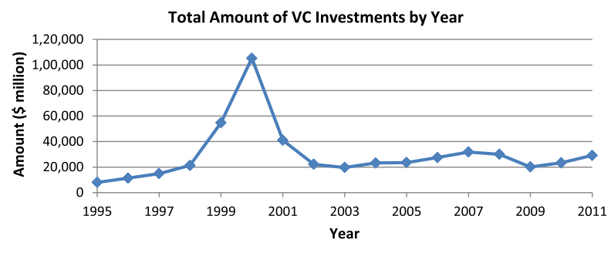
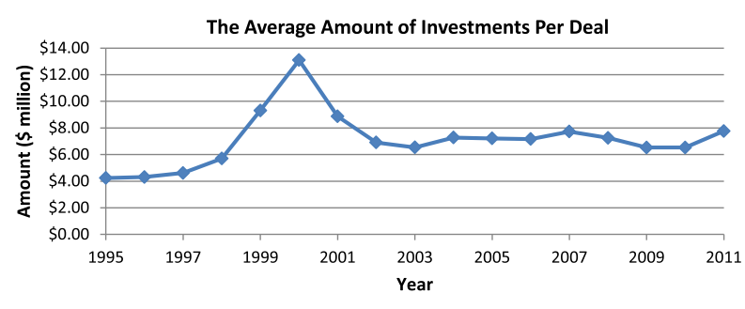

Slide 4
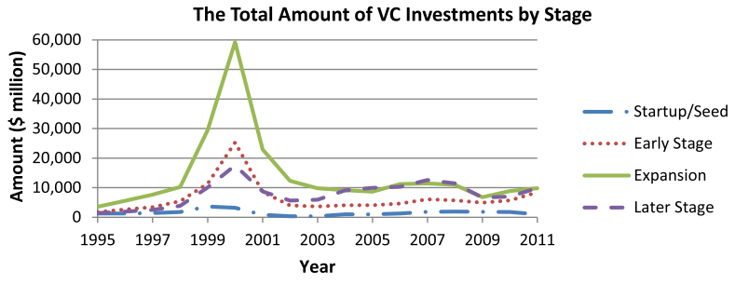
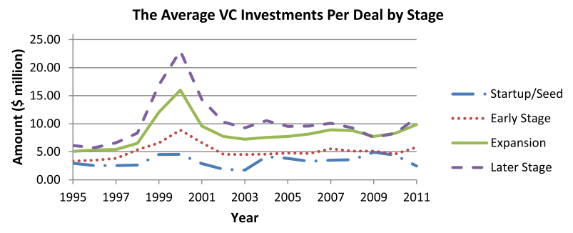

Slide 5
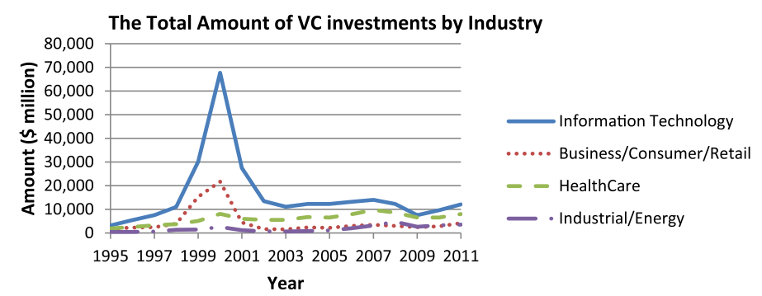
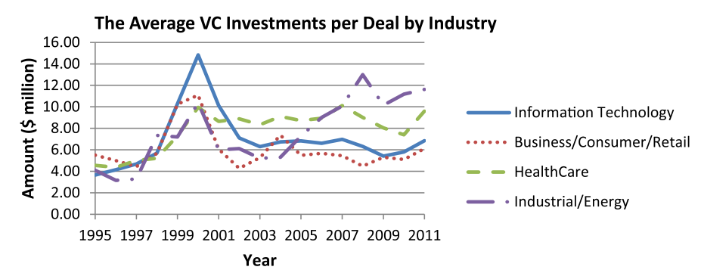
http://sites.nicholas.duke.edu/innovate/files/VentureCapital.html

Slide 6
Results
1. Good performance in the stock and bond markets affect the VC industry and drive up VC activities.
2. After the 2000 dot-com and 2008 financial crisis VCs invested less funds in fewer deals, shifting a larger proportion of their money and deals to later-stage companies.

Slide 7
Results
3. While a lower proportion of venture funds and fewer deals go to start-ups and early-stage companies after the 2000 high-tech bubble, a greater proportion of the funds and deals were actually allocated to the earlier-stages projects after the financial crisis occurred in 2008. A possible explanation → social media industry.

Slide 8
Reference
Ning, Yixi. “The driving forces of venture capital investments” J Small Business Economics, V 44, Issue 2. pp 315-344. Web: http://dx.doi.org/10.1007/s11187-014-9591-3. February 2015.

